Slide 1
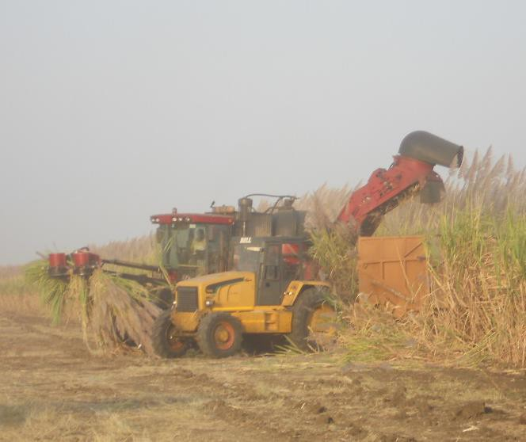
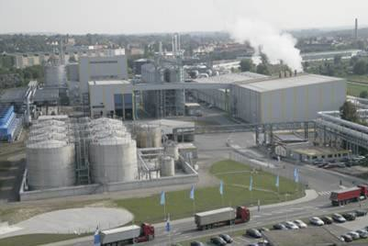
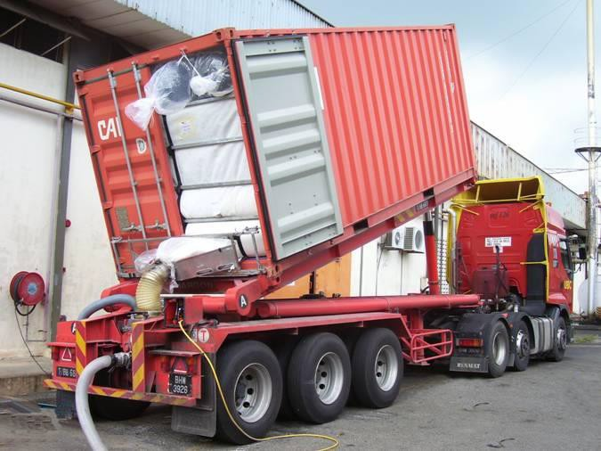
Good Sugar Manufacturing
Practice
Theo H de Beer
Carbo Solutions International
info@carboua.com

Slide 2
Abstract
2
Good manufacturing practice are steps taken to ensure maximum profitability and minimum losses in the factory operation.
The subject is vast, but three of the more pertinent points that is required for operating an efficient sugar refinery or raw house will be touched on very briefly in this presentation.
It is not rocket science and without going into too much detail, it is basically only the application of common sense that is required

Slide 3
Introduction
3
Get the sugar out as soon as possible. Minimise or where possible prevent recycling
Put into place measures & checks
“If you cannot measure it, you cannot manage it”
Get plant & equipment to do what it was originally designed and intended to do,
“back to basics”

Slide 4
Introduction
4
Before expanding on these, it is necessary to understand some of the fundamental effects in the process that if overlooked, it will result in sucrose destruction, hence losses and which can cost the factory a substantial amount in revenue

Slide 5
Introduction
5
At Low pH Sucrose inverts
It chemically breaks down and is no available for recovery and it is thus lost.
longer
At high temperature Sucrose also breaks down and also will be lost as above.
Extended retention will give the forces of inversion time to invert more sugar and further push up the losses

Slide 6
Low pH
6
At low pH and elevated temperatures sugar hydrolyses
into invert sugar.
Sucrose breaks down to form glucose and fructose which is not available for recovery and will therefore be lost – it will be reported as “undetermined loss”
^{C}12^{H}22^{O}5
Sucrose
+ H₂O
+ Water
^{C}6^{H}12^{O}6
Glucose
+
^{C}6^{H}12^{O}6
+ Fructose

Slide 7
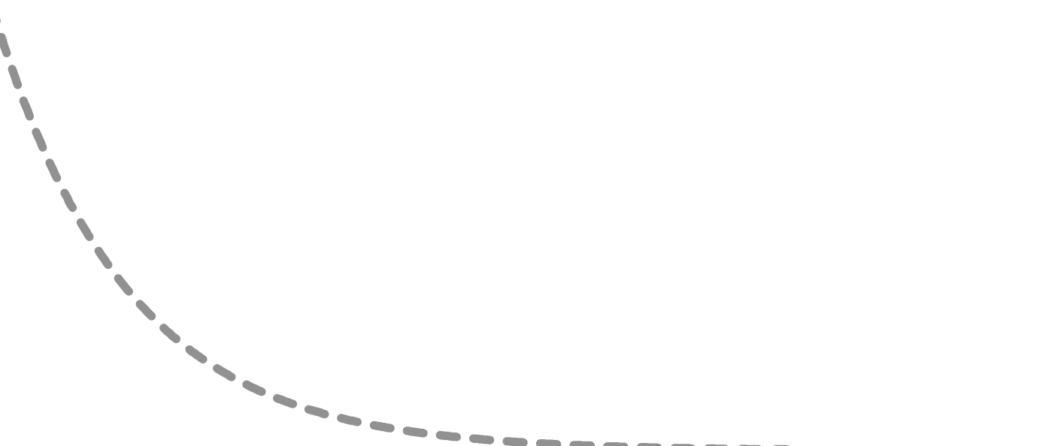
Rate of inversion
7
% Sucrose Inversion hr⁻¹ at 100
ºC & at Various pH Values
6
5
4
3
2
1
0
% Inversion
4.6
4.8
5.0
5.2
5.4
5.6
5.8
6.0
6.2
6.4
6.6
6.8
7.0
7.2
7.4
7.6
7.8
7.9
pH

Slide 8
Rate of Sugar Solution Inversion at Elevated Temperatures
8
1600
1400
1200
Percent Inversion
Taking the Rate of Inversion at
100ºC to be 100%
1000
800
600
400
200
0
Temperature ºC
25
40
45
50
55
60
65
70
75
80
85
90
95
100
105
107
110
115
120
125
130

Slide 9
% Sucrose Inversion / hour at
Different Temperatures and pH
9
5
% Inversion per hour
4
Temperature ⁰C
50
80
100
110
60
90
105
120
70
95
107
3
2
1
0
4.6 4.8 5.0 5.2 5.4 5.6 5.8 6.0 6.2 6.4 6
.6 6.8
7.0 7.2
pH

Slide 10
Vukov’s Formula Modified
10
Based on a paper by Vukov published in the International Sugar Journal of 1965 titled “Kinetic aspects of sucrose hydrolysis” the effects of temperature, pH and retention can be quantified.

Slide 11
Vukov’s Formula Modified
11
F G H I J L | M | N | O | P | Q | R | T | U
Flow Rate (m³ hr⁻¹) Retention vessel (m³) Retention (minutes) Operating Temp o_{C} pH Density temp corrected | pH (Brix Corrected) | dpH/dT | Operating pH | VUKOV (Log (K) | (K) | % Loss | Ton Sucrose exposed / hour | Sucrose inverted (hour⁻¹)
24.4 20.0 49.3 75 6.0 ^{1.303} | 5.56 | -3.0E-03 | 5.41 | -5.11 | 7.8E-06 | 0.039 | 6.34 | 0.0024
B
C
D
E
Ton Brix per hour
Ton per hour
Brix %
Purity
20.0
63.0 99.9 31.7
Density temperature correction =0.998+(0.00372*Brix)+(0.00001778*Brix ²)
pH corrected for Brix =pH-(0.014*(Brix/2))
dpH/dT =-0.0339+(0.015*corrected pH)-(0.0017*(pH Brix corrected²))
Operating pH =((Temperature – 25) *(dpH/dT)+(pH Brix corrected)
Vukov (Log K) =16.91+LOG(Density temp corrected*(1-(Brix/100)))- (5670/(273+Operaring temp))-Operating pH

Slide 12
12
Ton Brix per hour | Brix % | Purity | Ton per hour | Flow Rate (m³ hr⁻¹) | Retention vessel (m³) | Retention (mins) | Operating Temp ºC | pH | Ton Sucrose exposed / hour | Sucrose inverted (hour⁻¹) | Ton Sucrose inverted (Week⁻¹)
20.0 | 63.0 | 99.9 | 31.7 | 24.4 | 20.0 | 49.3 | 75 | 6.0 | 6.34 | 0.0024 | 0.37
20.0 | 63.0 | 99.9 | 31.7 | 24.4 | 15.0 | 36.9 | 75 | 6.0 | 6.34 | 0.0018 | 0.27
20.0 | 63.0 | 99.9 | 31.7 | 24.4 | 10.0 | 24.6 | 75 | 6.0 | 6.34 | 0.0012 | 0.18
20.0 | 63.0 | 99.9 | 31.7 | 24.4 | 15.0 | 36.9 | 85 | 6.5 | 6.34 | 0.0025 | 0.37
20.0 | 63.0 | 99.9 | 31.7 | 24.4 | 15.0 | 36.9 | 75 | 6.5 | 6.34 | 0.0008 | 0.11
20.0 | 63.0 | 99.9 | 31.7 | 24.4 | 15.0 | 36.9 | 65 | 6.5 | 6.34 | 0.0002 | 0.03
20.0 | 63.0 | 99.9 | 31.7 | 24.4 | 15.0 | 36.9 | 75 | 8.0 | 6.34 | 0.0001 | 0.01
20.0 | 63.0 | 99.9 | 31.7 | 24.4 | 15.0 | 36.9 | 75 | 7.0 | 6.34 | 0.0003 | 0.05
20.0 | 63.0 | 99.9 | 31.7 | 24.4 | 15.0 | 36.9 | 75 | 6.0 | 6.34 | 0.0018 | 0.27
20.0 | 63.0 | 99.9 | 31.7 | 24.4 | 15.0 | 36.9 | 75 | 5.0 | 6.34 | 0.0142 | 2.13
20.0 | 67.0 | 99.9 | 29.9 | 22.5 | 15.0 | 40.0 | 75 | 6.5 | 5.96 | 0.0007 | 0.1108
20.0 | 63.5 | 99.9 | 31.5 | 24.1 | 15.0 | 37.3 | 75 | 6.5 | 6.29 | 0.0008 | 0.1139
20.0 | 60.0 | 99.9 | 33.3 | 25.9 | 15.0 | 34.7 | 75 | 6.5 | 6.66 | 0.0008 | 0.1161
20.0 | 63.0 | 99.9 | 31.7 | 24.4 | 15.0 | 36.9 | 75 | 6.5 | 6.34 | 0.0008 | 0.1143
20.0 | 63.0 | 98.0 | 31.7 | 24.4 | 15.0 | 36.9 | 75 | 6.5 | 6.22 | 0.0007 | 0.1121
20.0 | 63.0 | 97.0 | 31.7 | 24.4 | 15.0 | 36.9 | 75 | 6.5 | 6.16 | 0.0007 | 0.1110

Slide 13
Sucrose Inversion
13
It is therefore important to control the pH in the
process. Run as close to neutral as possible
– Keep temperatures down where possible
– Minimise
retention, or run at as high a
throughput as possible.
Where equipment is run in parallel, when throughput drops, try and take equipment off line and park them off, rather than slowing the operation of that plant

Slide 14
Sucrose Inversion
14
Even in the best run factory, chemical breakdown is inevitable and it can be expected to be in the order of about 1.5% of the sugar input in a raw house
This is made up approximately :
0.3% lost between juice massing and clarifier outlet 0.5% lost across the evaporators
0.7% lost between pans & final sugar massed out

Slide 15
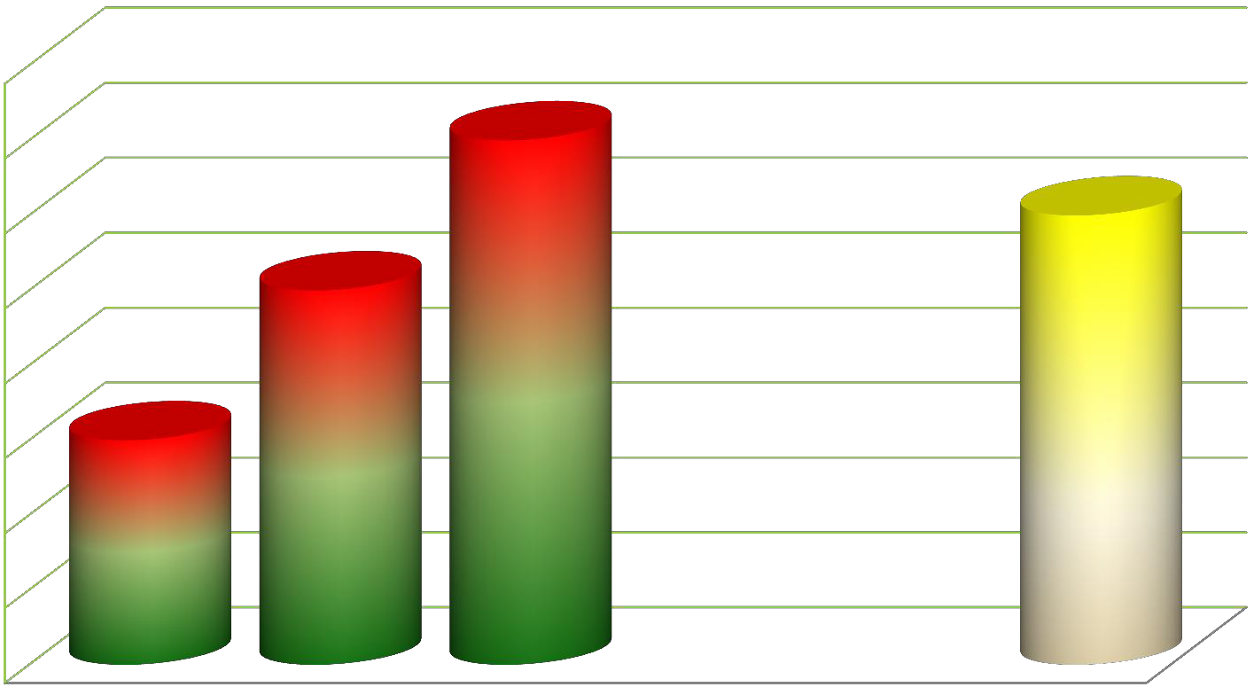




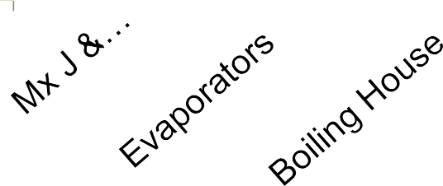
15
Typical Undetermined Loss Profile
% Undetermined Loss
0.8
0.7
0.6
0.5
0.4
0.3
0.2
0.1
0
0.7
0.6
0.5
0.3

Slide 16
Sucrose Losses
16
This means sugar recycled, will be exposed to chemical breakdown each time it is recycled.
Sugar returned to mixed juice tank will be exposed to
the 1.5% loss twice, its loss will therefore be 3%
Sugar returned to syrup is exposed to 1.5 + 0.7 = 2.2%
undetermined loss instead of the usual 1.5% Loss.

Slide 17
Sucrose Losses
17
As a guide, if it is necessary to recycle sugar, return it back as far down the process as is possible. Try and send it back to product of a similar purity.
But the ultimate aim should always still be
refrain from recycling.
Get the sugar out as soon as possible

Slide 18
Sucrose Losses
18
These losses due to recycling applies not only to crystalline sugar, but also to spillages during the process and to excess washing in the centrifugal which will dissolve sugar and will then be recycled
At 85ºC 20 g water dissolve 80 g sugar (1:4)

Slide 19
Sucrose Losses
19
Spillages, leaks & glands passing are avoidable.
But if they do occur, clean up immediately, before
microbial degradation sets in.
Repair leaking glands, pipes, tanks etc immediately. So often it is perceived that if spillages are recovered
it does not matter. This is totally false. If the spill is recycled it will incur loses. If it is left unattended to, microbial activity will set in and drop the pH and invert sucrose

Slide 20

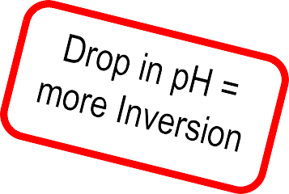


Sucrose Inversion losses
20
Sucrose
Undet loss
Loss
Mol loss
pH Temp Time
Reducing
Sugar
More molasses Increase loss in molasses
Sucrose
Microbial
degradation
Melassegenic
& Physical
Higher
viscosities
Loss in crystallisation & fugal wash & recycle

Slide 21
Sucrose Losses
21
Taking a practical look at a few areas in the operations where sucrose degradation often take place and thereby push up losses.
These will briefly be discussed.

Slide 22
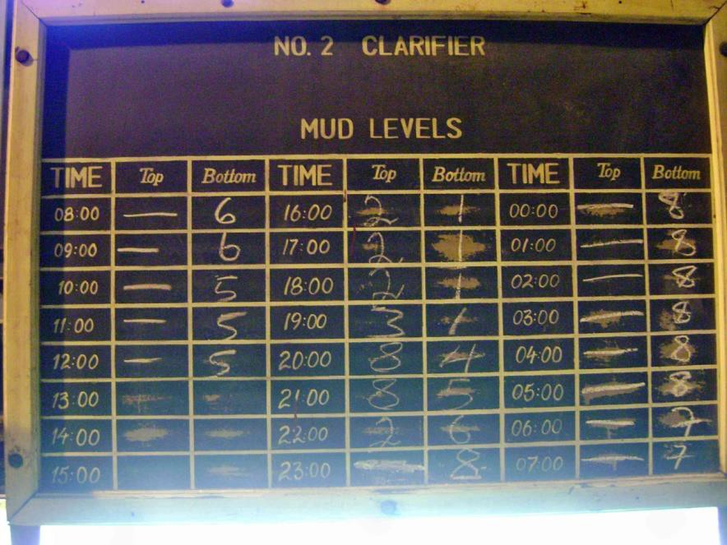
22
Mud levels in Clarifiers
Multi tray (Rappi Dorr units)
Table on left is actual mud
levels seen at a mill
Sucrose Loss in Clarifier
In Overflow (Clear Juice) & in Underflow (Mud) at
50
45
40
35
30
25
20
15
10
5
0
Different Mud Levels)
T Sucrose Lost in Mud / Week
Get mud out Do not build up mud levels in the
vessel
Ton Sucrose Inverted in Mud (per week)
Ton Sucrose Inverted in Clarifier Juice (per week)
1
2
Le ³ l at
_{ve} 4 5
Which M
6
perated at
ud is O
7
8

Slide 23
Effect of Velocity on HTC
23
Heat Transfer Coefficient
0.95
0.90
0.85
0.80
0.75
0.70
0.65
0.60
0.35
0.70 1.05 1.39 1.74 2.09 2.44
Velocity of juice flow inside tube
2.79
Low velocity results in Low HTC this means exposed
to heat for longer & high localised heating

Slide 24
Measurement and Control
24
Put into place measures and checks
“If you cannot measure it, you cannot manage it”
This is not always appreciated and often viewed
only as a nuisance with no benefit

Slide 25
Measurement and Control
25
It is important to put into place regular mass balances to calculate recoveries and losses at least on a weekly basis. With the advent of technology this can be done far more regularly, much easier
Have laboratory results displayed in the plant for the operators to see and so that they can make the necessary adjustments to rectify problems
Make them available to all concerned

Slide 26
Measurement and Control
26
Check lists should cover daily routine operations, schedule stop-day work and maintenance jobs.
List the required jobs, delegate individuals to carry out the job. They must then fill out the check sheet, sign it off, thereby verifying the state of the job & take responsibility that the job was carried out correctly .
Lists must then be scrutinise by the supervisor and or manager who must then check a few jobs and be satisfied the work was done satisfactorily.

Slide 27
A Typical example of a check list
27
No | STOP DAY CHECKLIST | SIGN
1. | Check flash tank level trips
2. | Liquidate flash tank
3. | Empty out MJ heaters
4. | Clean and wash pH pot
5. | Pump water through Rotameters
6. | Pump water through lime pump & pipes
7. | Keep 3 containers Biocide at Clarifiers ( For use during day)
8. | Wash out CJ sample tubes
9. | Empty &wash lime tank (Diffuser supply)

Slide 28
28
A Typical example of a check list
No | STOPDAY CHECKLIST | SIGN
1. | Dose biocide 10 ℓ in each Clarifier
2. | Open flash tank manhole door
3. | Open surge tank manhole door
4. | Wash mixed juice scales: Top & bottom
5. | Wash surge tank
6. | Wash flash tank until clean

Slide 29
A Typical example of a check list
29
No | STOPDAY CHECKLIST | SIGN
1. | Mix flocculant (12h00)
2. | Inspect surge tank and box up
3. | Inspect flash tank and box up
4. | Assist evaporator attendant (14h00- 16h00 shift)
5. | Prepare for start up (16h00-18h00 shift)
6. | Clean Clarifier inlet boxes:-

Slide 30
30
Check sheets must be allocated for all sections covering all duties of the different shifts, for both routine operations and for scheduled stop work and for maintenance work.
Developed check sheets for each job.
CLARIFIER ATTENDANT:
EVAPORATOR ATTENDANT
OLIVER FILTER ATTENDANT
PUMP ATTENDANT
A PAN BOILERS
B/C PAN BOILERS
CENTRIFUGAL SUPERVISOR
FINAL INSPECTION, before boxing up

Slide 31
Measurement and Control
31
Follow up and repeatedly inspect
This is always a very important role and can
save plenty of time
A leaking manhole gasket on a
₁st
effect
evaporator once steam lines are pressurised will delay start up for a few hours, as the steam pressure has to be lowered again and the vessel cooled before access is possible to rectify the problem if it was not checked

Slide 32
Measurement and Control
32
It is of utmost importance that communication between departments are good
Production,
Engineering/maintenance
Warehousing
Packaging
Each is a provider and each has a customer down
stream. Treat them accordingly
Communications between shifts at shift change

Slide 33


33
Inspect rather than Expect
This is very important
There should be evidence of people’s
footprints throughout the factory

Slide 34




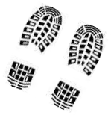






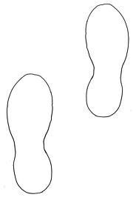

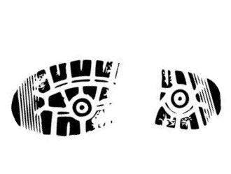


34
Mr Manager
Foreman
Operator
Move around, inspect rather than expect
Technician Planning, Quality Electricians,mechanics

Slide 35
Laboratory
35
The laboratory plays a vital role in operations. It is a vast subject on its own but it is good to look at a few important points and discuss these briefly.
After all this is the place most measuring is
initiated from.
Operators must be confident of the figures they are expected to react on, so it is in their interest to keep in close liaison with the quality control department - For the benefit of both operations & quality control.

Slide 36
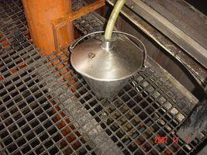
Laboratory
36
Results are only as good as the sample is
In the interest of all concerned and to ensure laboratory
results truly represent the product:
Ensure:
•Samples are representative.
Wash clean & dry receptacles, or rinse with product
•Sample is not contaminated or evaporates.
•Keep receptacles closed
•Cool if possible

Slide 37
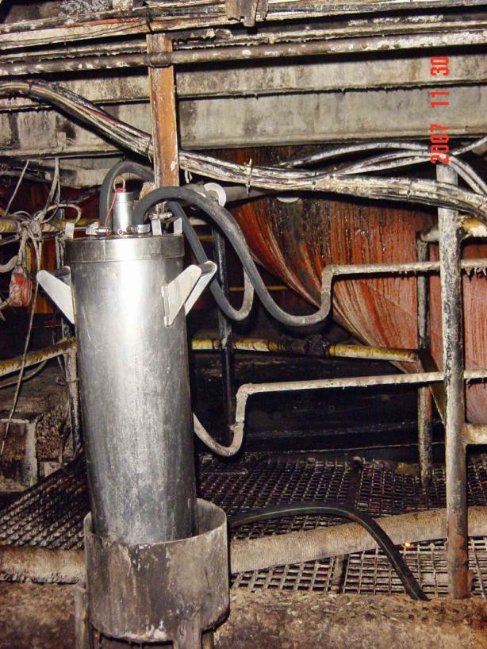
37
Mixed Juice Sampler / Cooler
Juice
Flow
Warm water out Return to chiller
Chilled water in
Cooling jacket with Chilled water Passing through
Depending on cane payment method this can be an important test & all possible precautions must be taken

Slide 38
38
Sampling Molasses / Run Off
from a delivery line
A
Because the line cools & at times choke when the sample valve is throttled to prevent sample container overflowing, put in a by-pass line and run this and tap off this hot circulating stream with a short stub.
Valve A fully open
Valve B throttled to fill bucket
³/₄ over the sample period
B
A
B

Slide 39
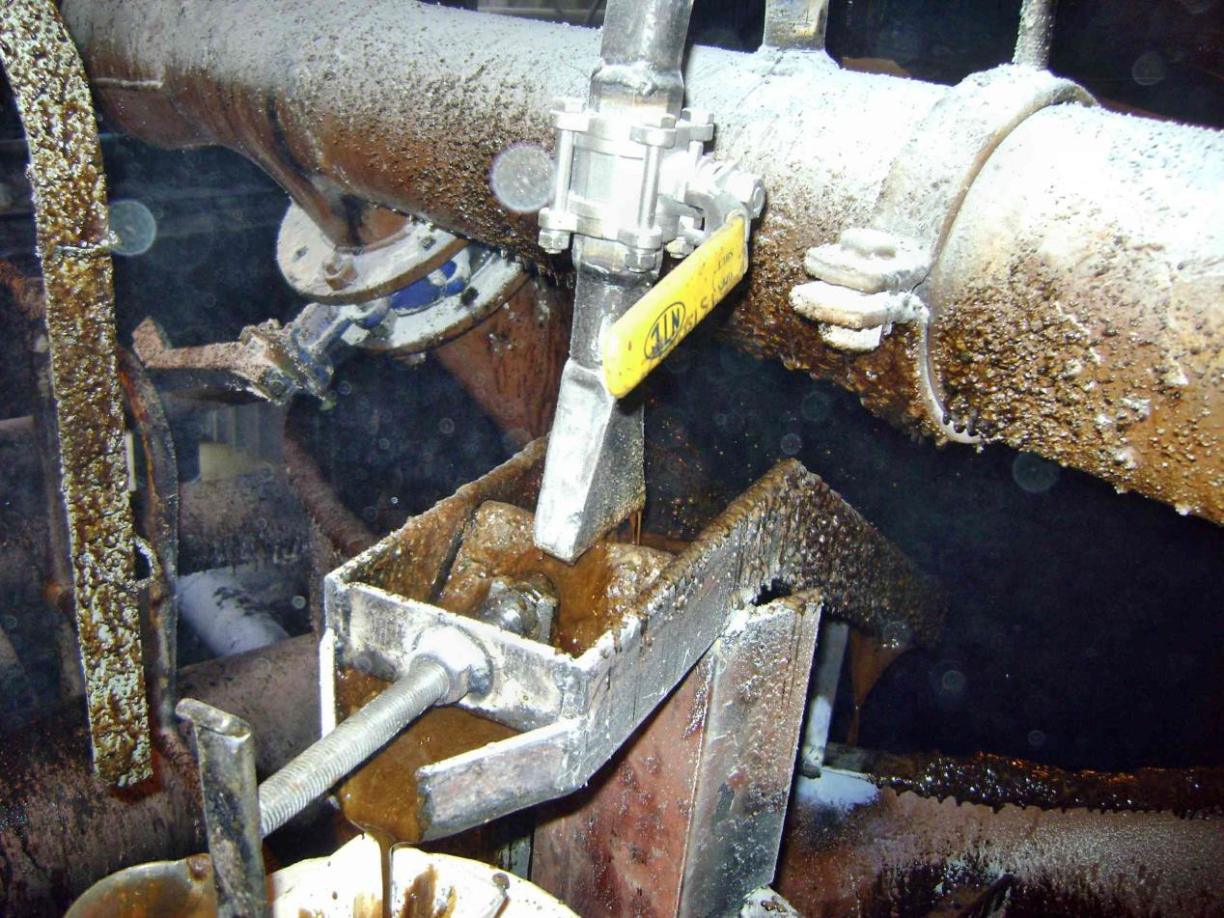
39
Syrup sampler. Adjust sample rate to get the sample bucket about ¾ full at the end of the sample period

Slide 40

40
One of many sugar Samplers
sampling falling sugar in a
closed pipe.
Cylinder driving piston
Timer
Sample
Container

Slide 41
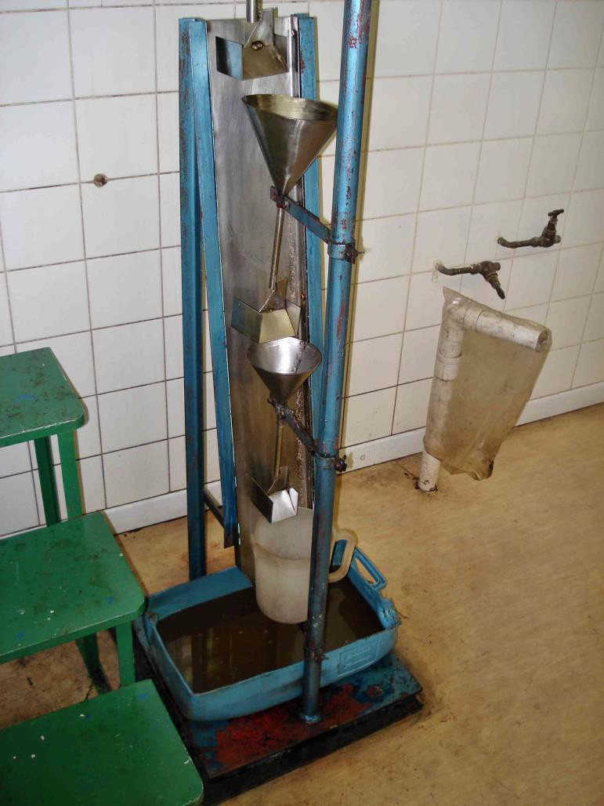
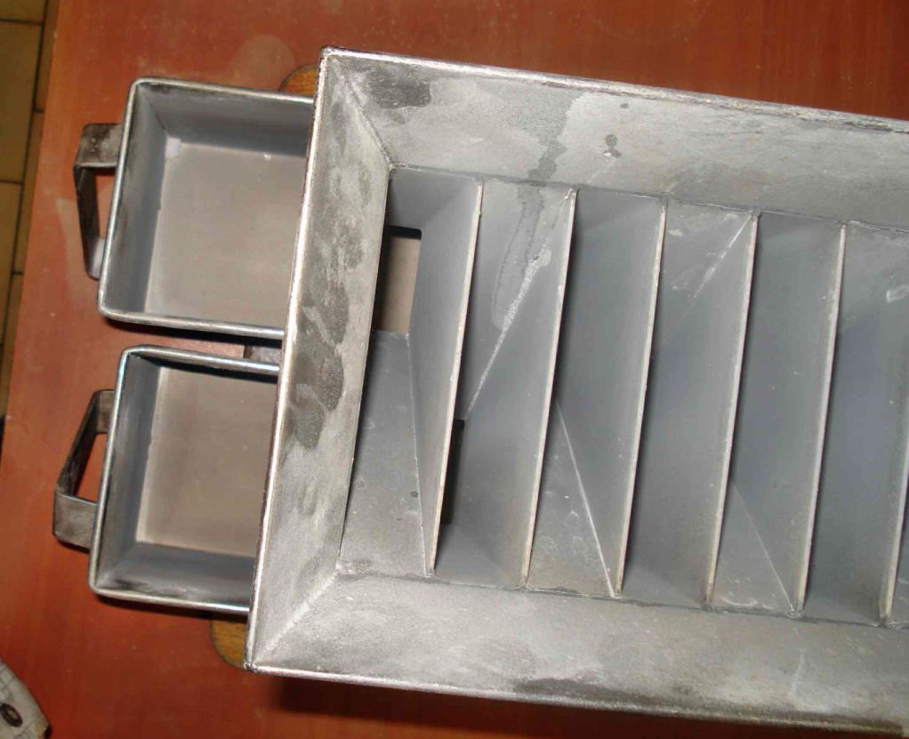
41
Rifflers for sub-sampling products like Sugar & Suspended solids in juice
If analyse suspended solids in juice, which has floaters & sinkers. Pouring off the sample, even after it is well stirred, floaters will come off & sinkers remain behind.
With sugar different grain sizes separate on the belt

Slide 42
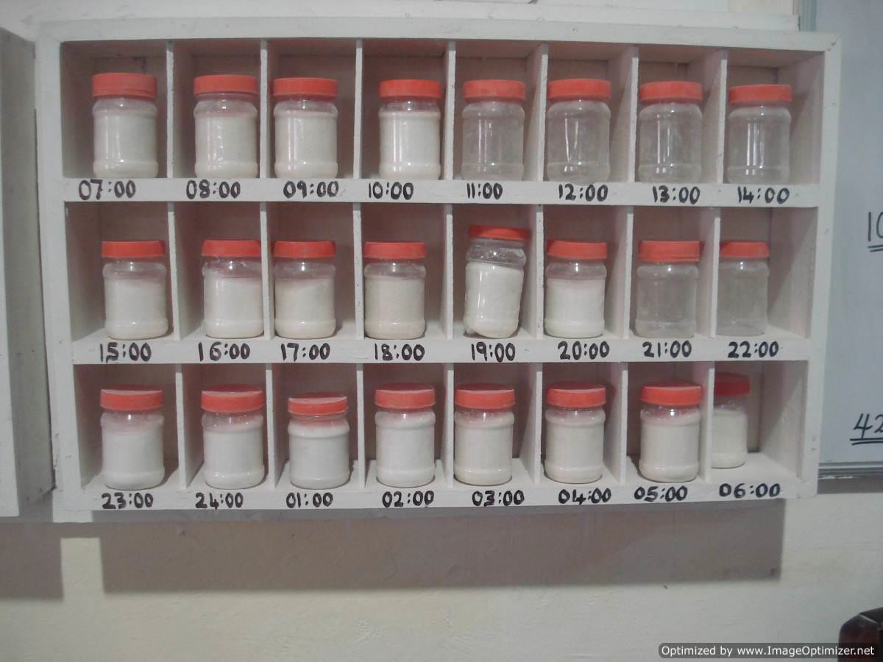
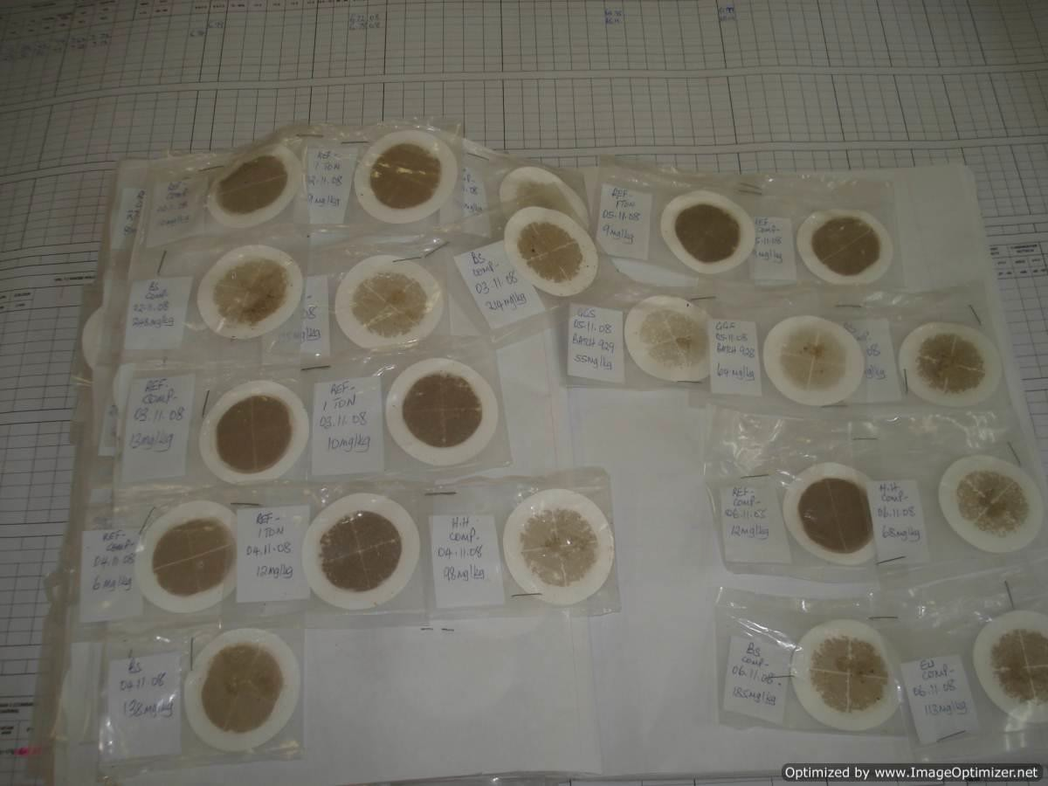
42
Display hourly results for all to see
Visual displays are often simpler to understand than
figures
It also keeps the following shift informed of the current
situation
Mechanical / Electrical can make adjustments Marketing knows what is available Management is informed of the situation

Slide 43
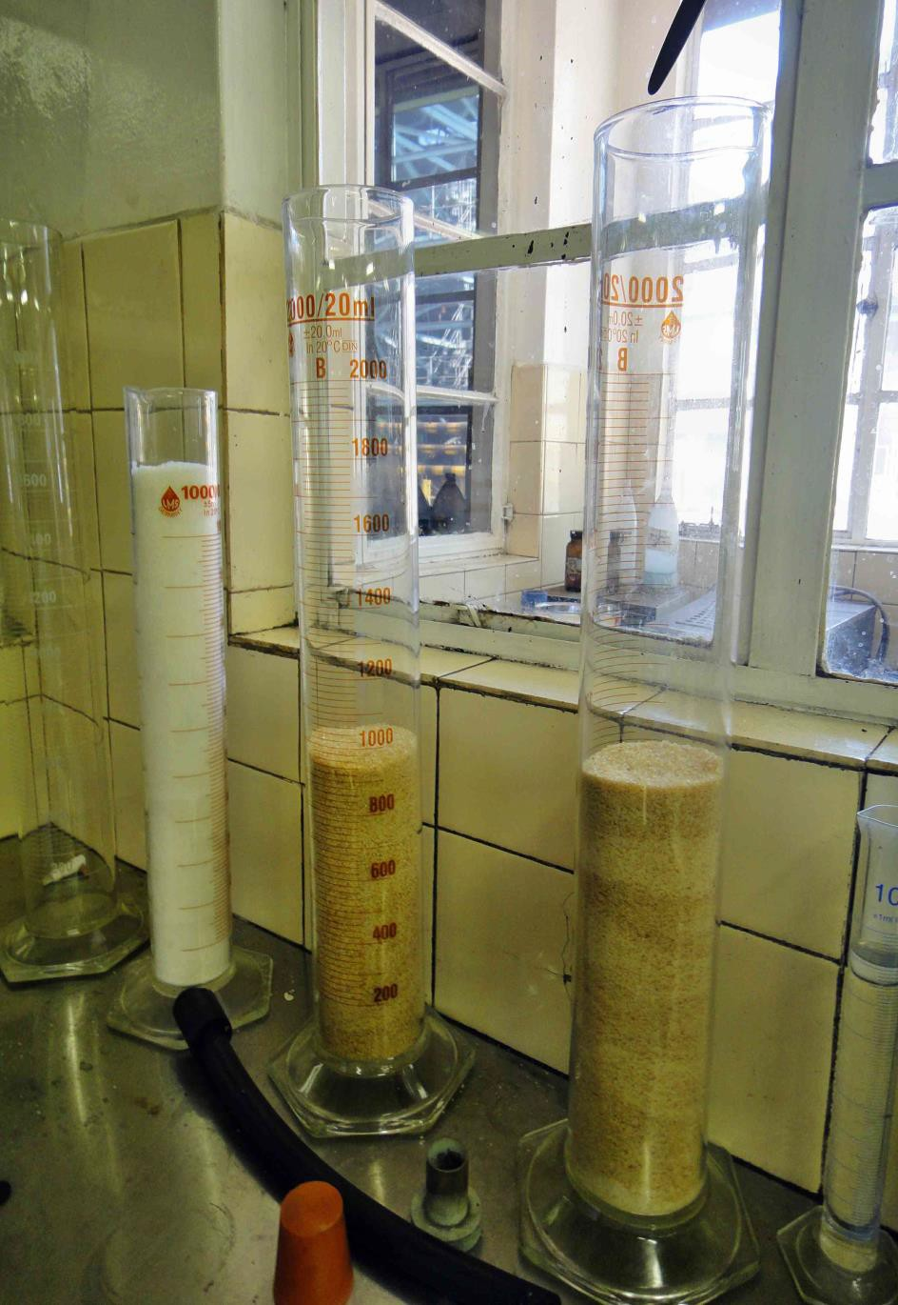
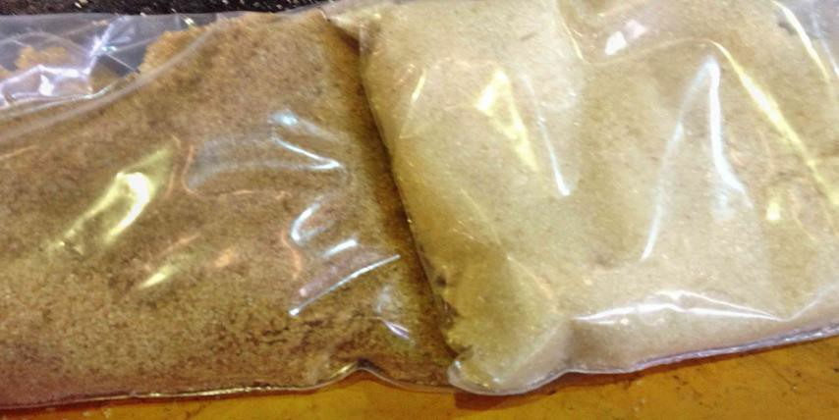
43
This could raise questions or initiate investigations as to why is the quality is varying from one hour to the next?”

Slide 44
44
It is not uncommon for people to modify equipment without really knowing the basic principles and end up changing what has been developed by the supplier over a period and after plenty of research and development
Or often the affect of defects are not appreciated

Slide 45
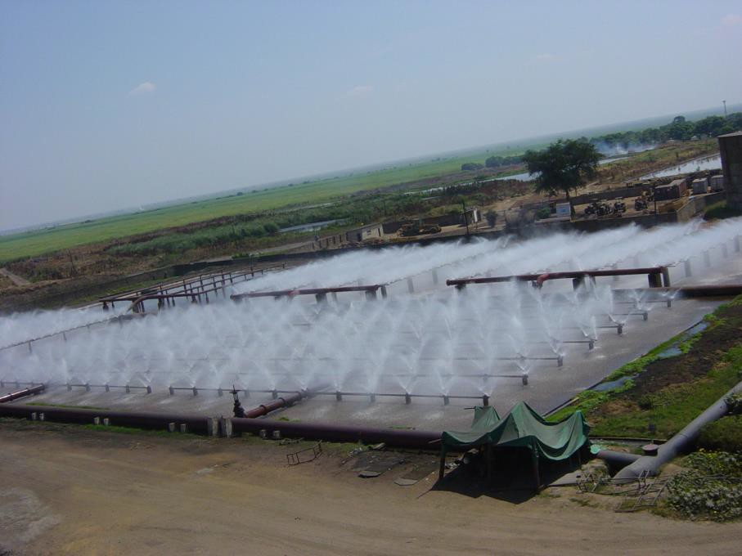
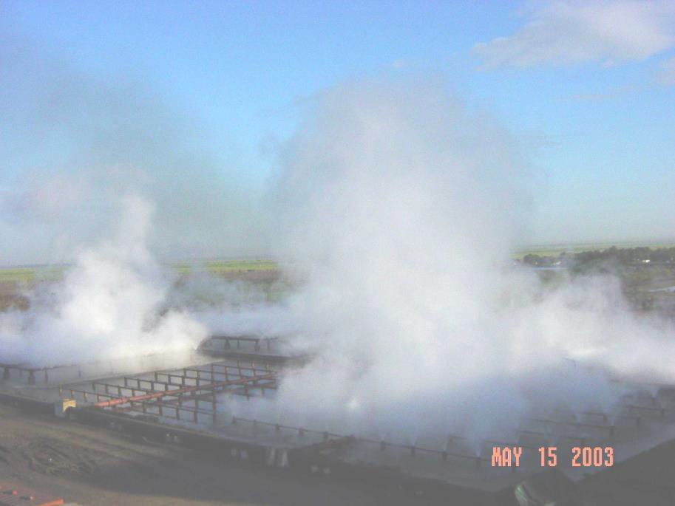
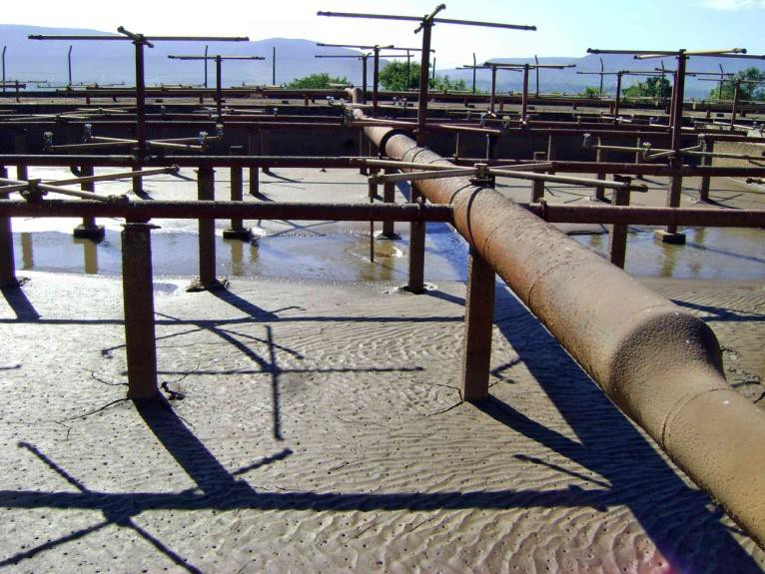
In the centre RH is 100%
45
Would have been better to extend length
Effectiveness of spray pond depends on the atmospheric RH (Relative humidity)
At RH 100%, there is no evaporation, hence no cooling is achieved
This spray pond expansion would have been better to extend length wise rather than making it wider
.
Double layer spray
also no good

Slide 46
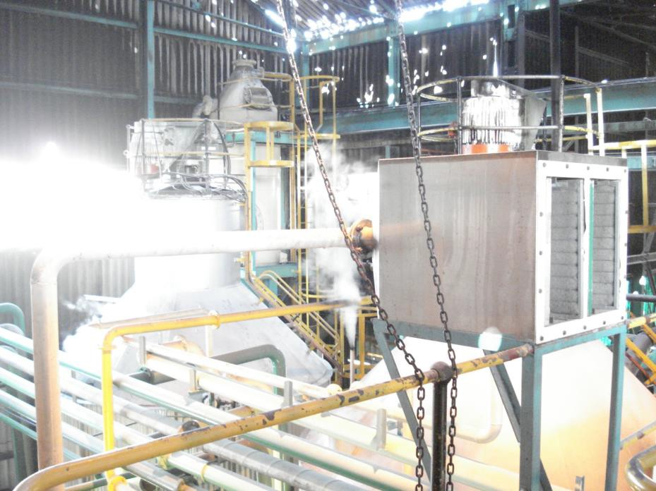
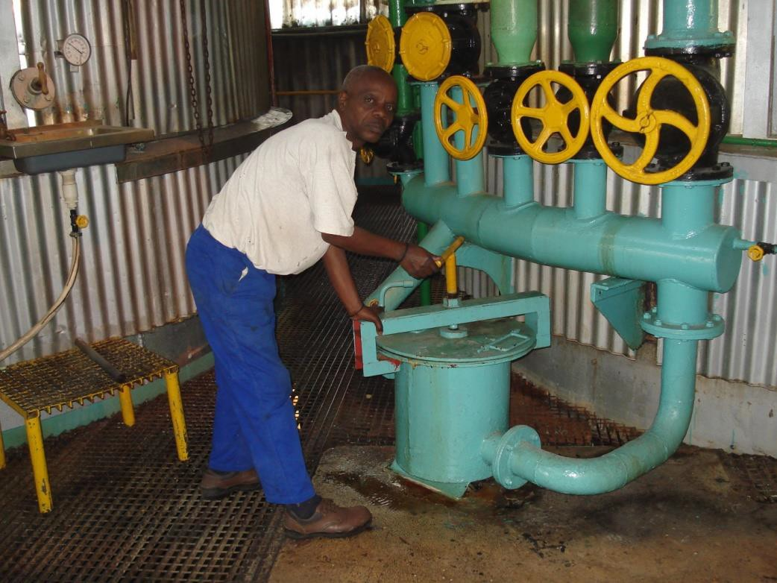
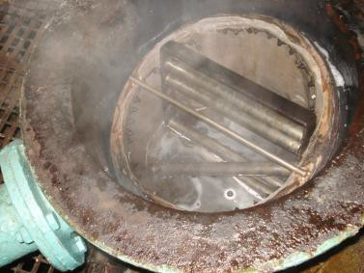
46
The extent to which some people go to keep
suspended solids levels down in sugar.
Filter air intake when the pan breaks vacuum It would be better to break vacuum with steam Magnet in pan feed – use Stainless steel piping
Prevent rather than cure

Slide 47
47
Taking a 1750 “A” centrifugal (Charge 1750 lt) If wash water is increased by 2 seconds
This will be an additional 4.5 liter wash water
This water can dissolve 18 kg sugar Sugar that will be recycled and reworked Taking a 250 TCH factory (5400 TCD)
This will be 4 000 ton sugar recycled / annum Taking a conservative figure of US$ 15 as the cost of reworking the sugar (Ops and energy)
Recycling will cost $60 000

Slide 48
48
Not only is it rework cost, there will also be
chemical loss when recycling the sugar.
The dissolved sugar will end up in the run off and increase run off purity which will drop the exhaustion
It can be shown that 2 second extra wash will
drop exhaustion by 1.44 units
Since 1 unit exhaustion will elevate the UDL (Undetermined loss) by 0.035%
1.44 units exhaustion ≡ 0.05 increase in UDL

Slide 49
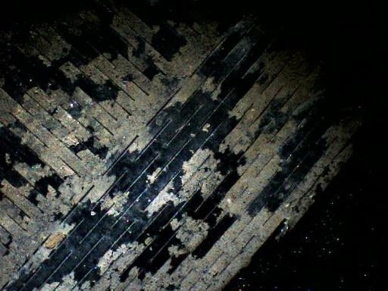
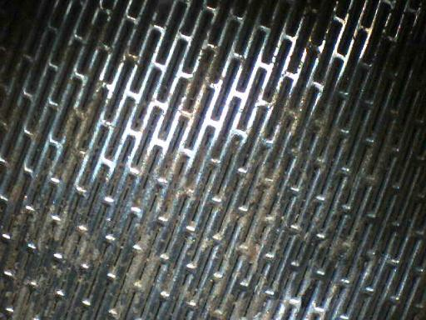
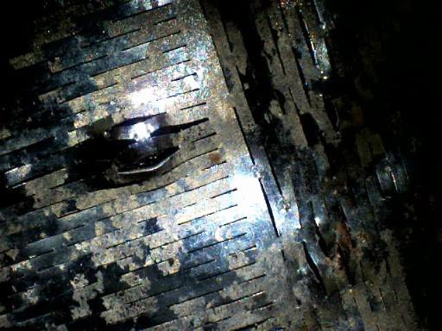

49
There is a correct and an incorrect way to fit the screens
It does not look like a serious dent, but take a closer look

Slide 50
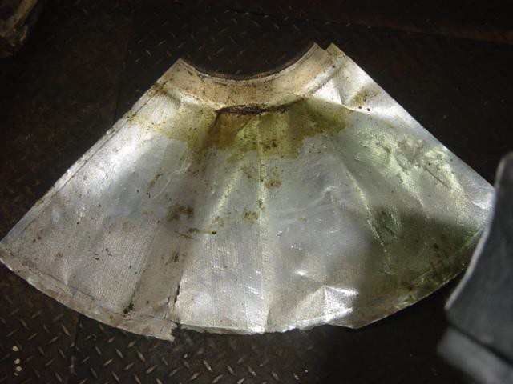
Some factories renew C centrifugal screens routinely every 4 to 6 weeks, cascade the old C screen to B duty
50

Slide 51
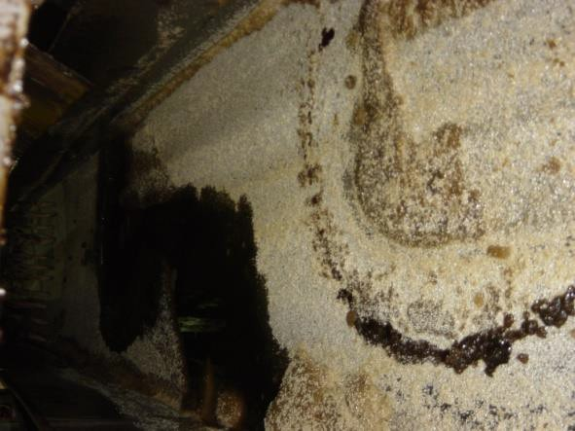
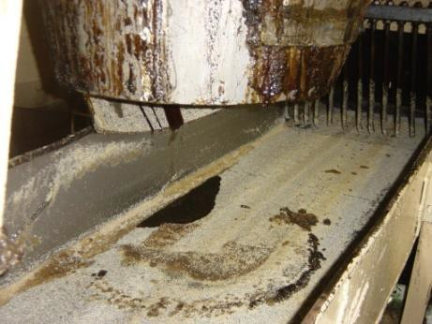
51
Drip gates passing raises sugar colour & the first reaction of the operator is to add more water
This will dissolve sugar which effectively will have to be recycled (Increase undetermined loss)

Slide 52
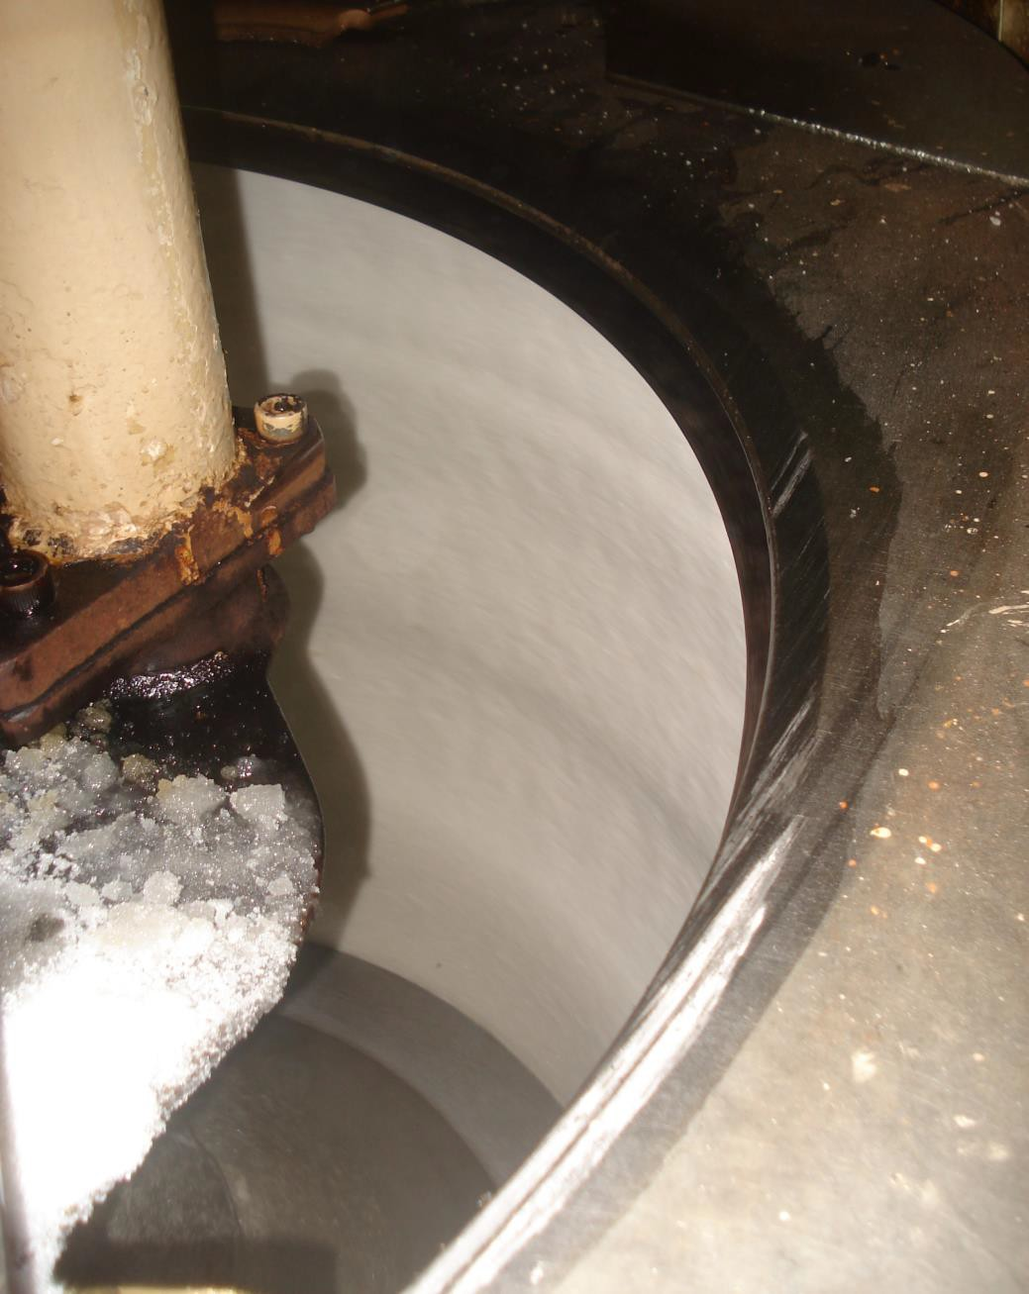
52
Look for tell tale
signs in the
operation.
Typically the pattern on the sugar face in a centrifugal basket can indicate possible problems

Slide 53
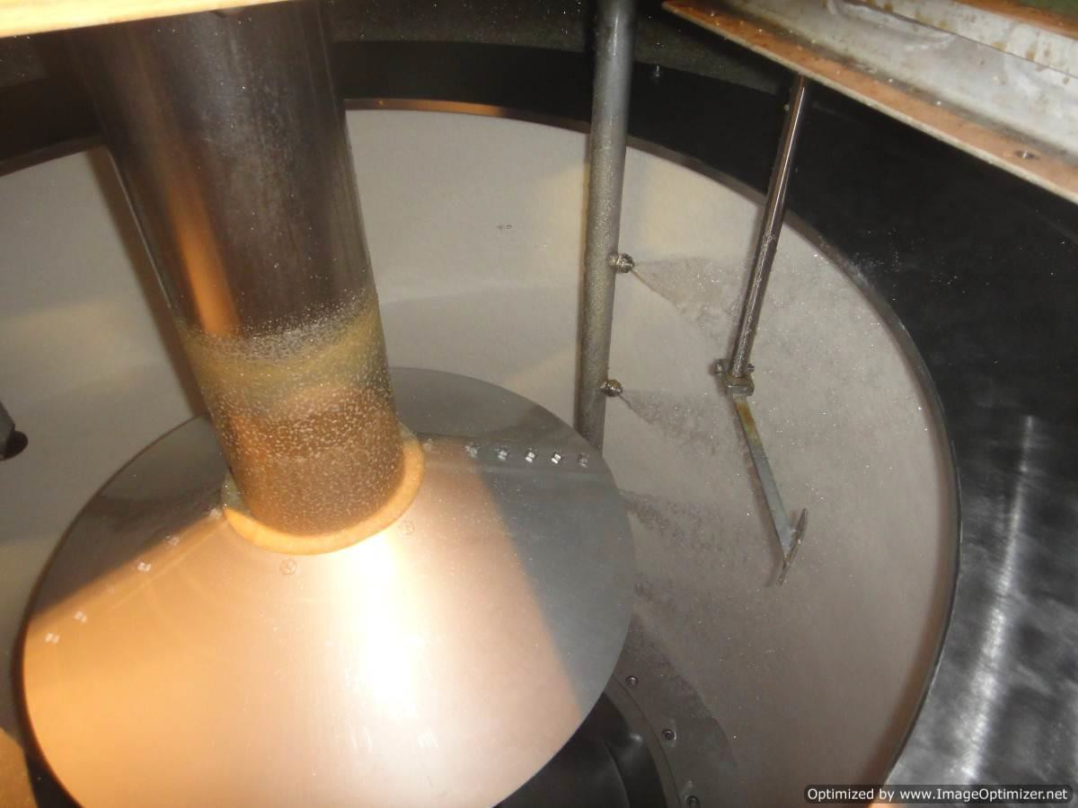
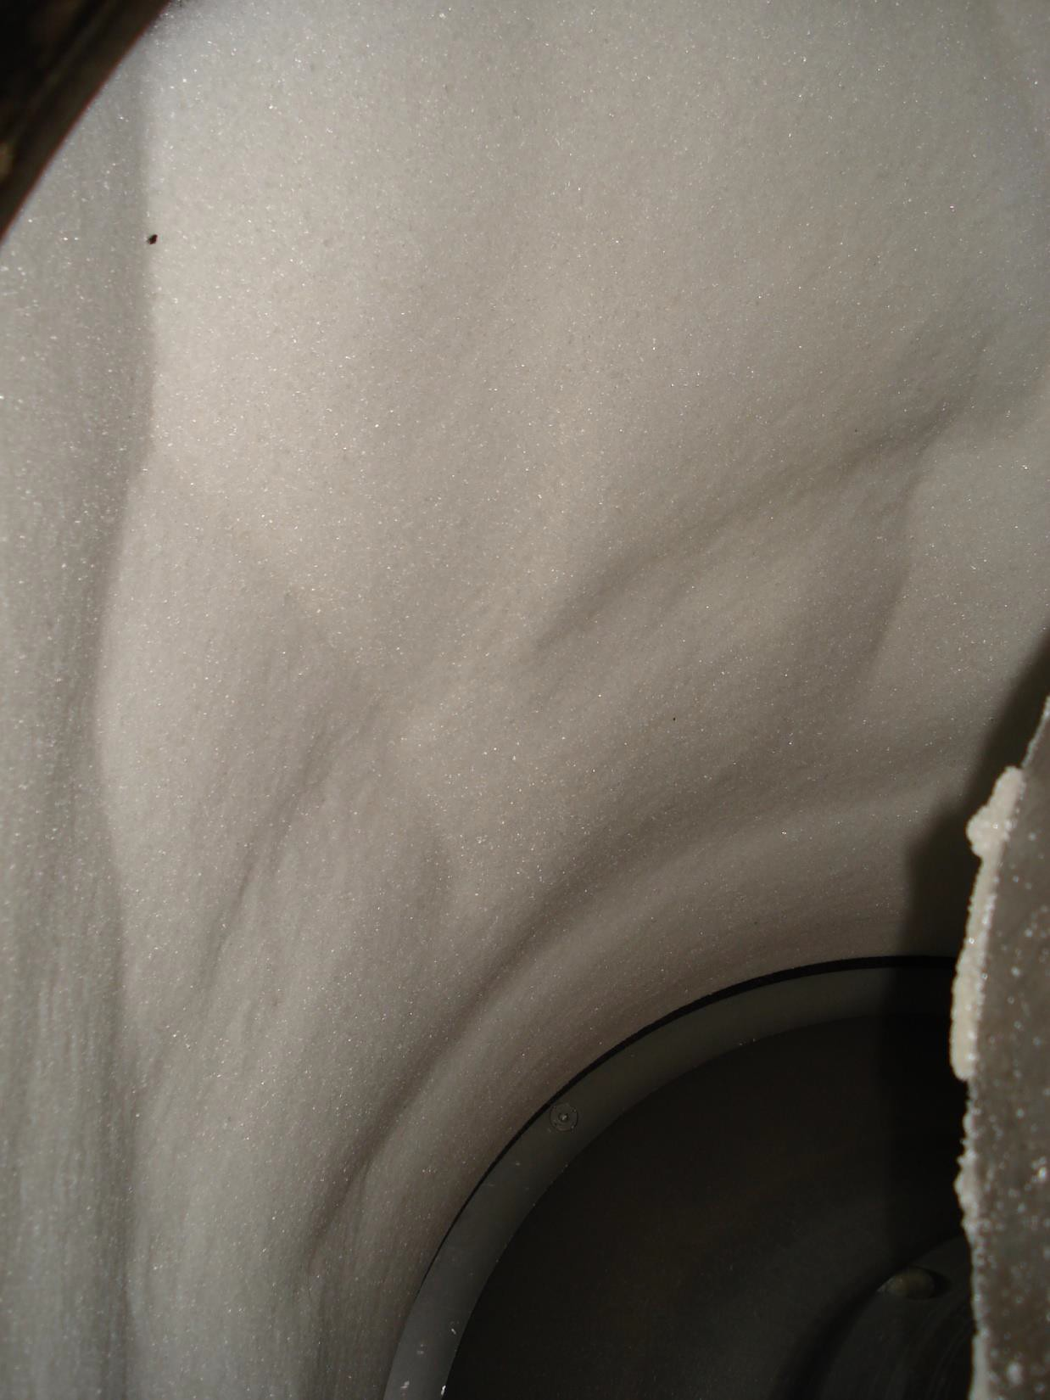
53

Slide 54
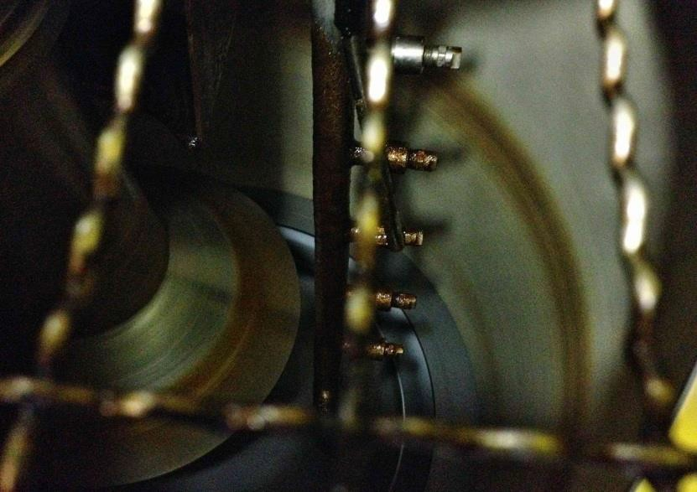
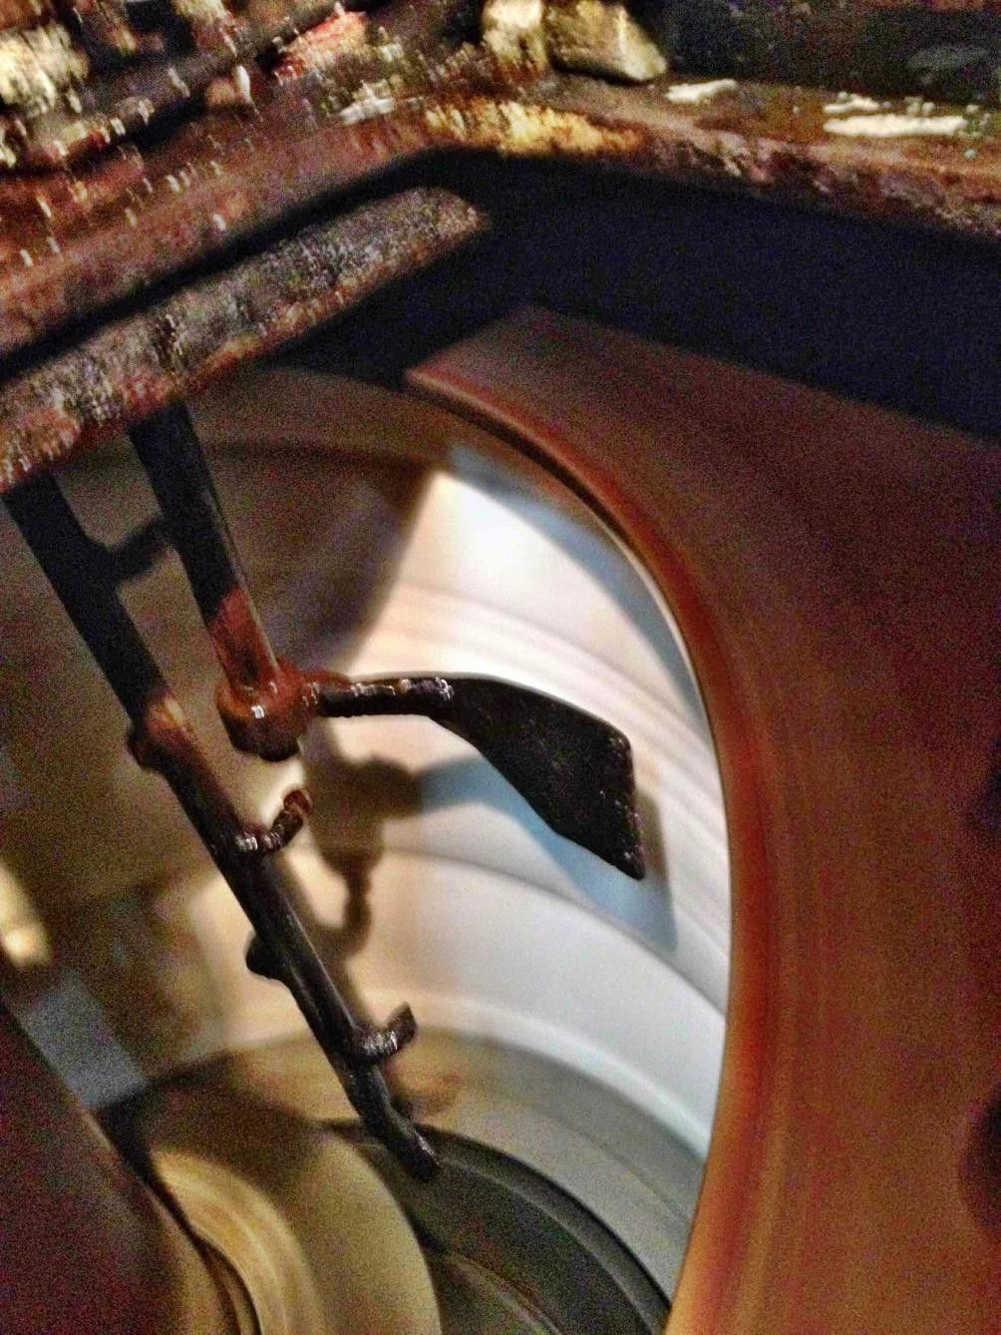
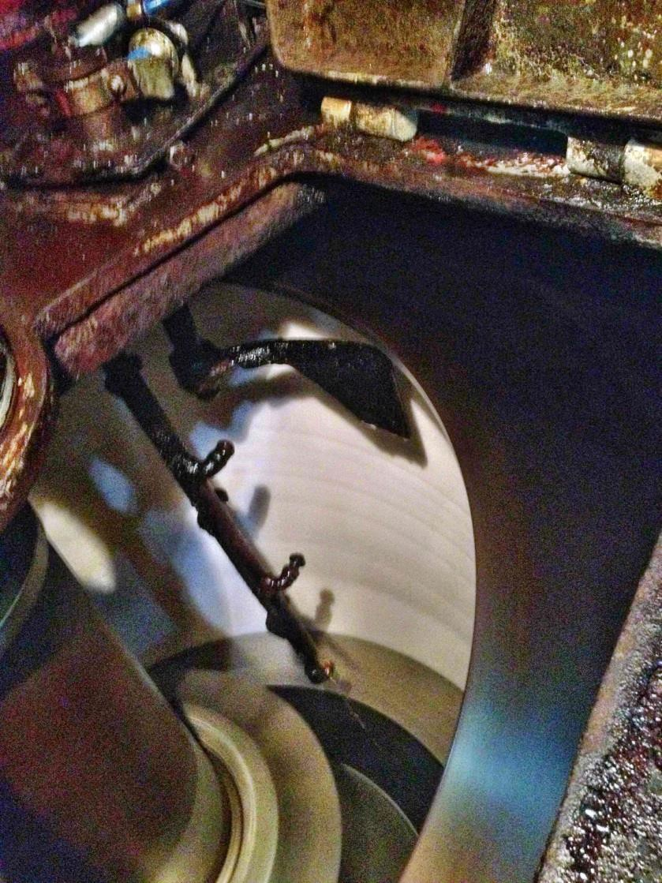
54

Slide 55
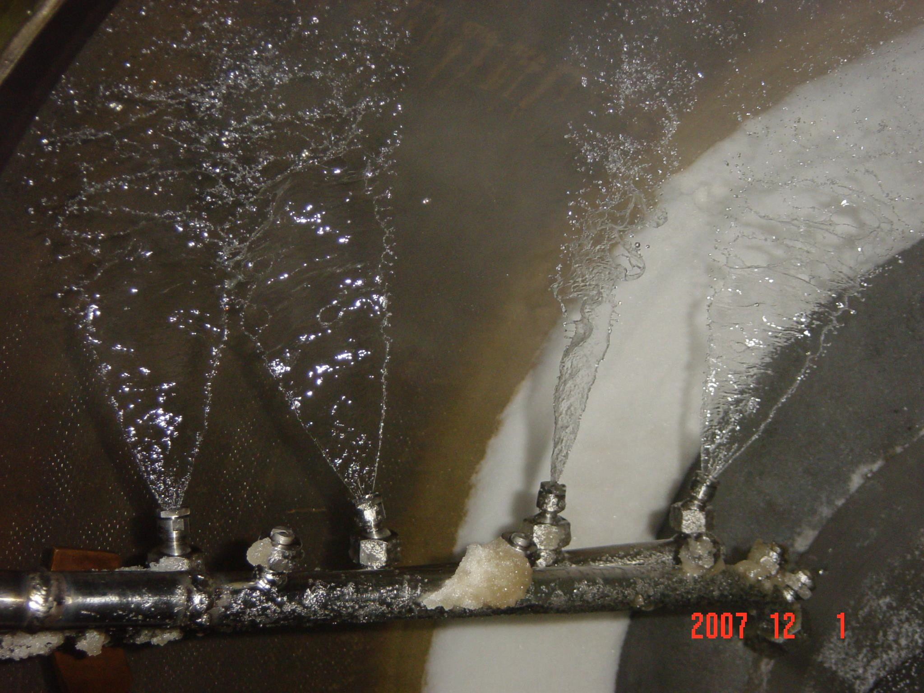
55

Slide 56
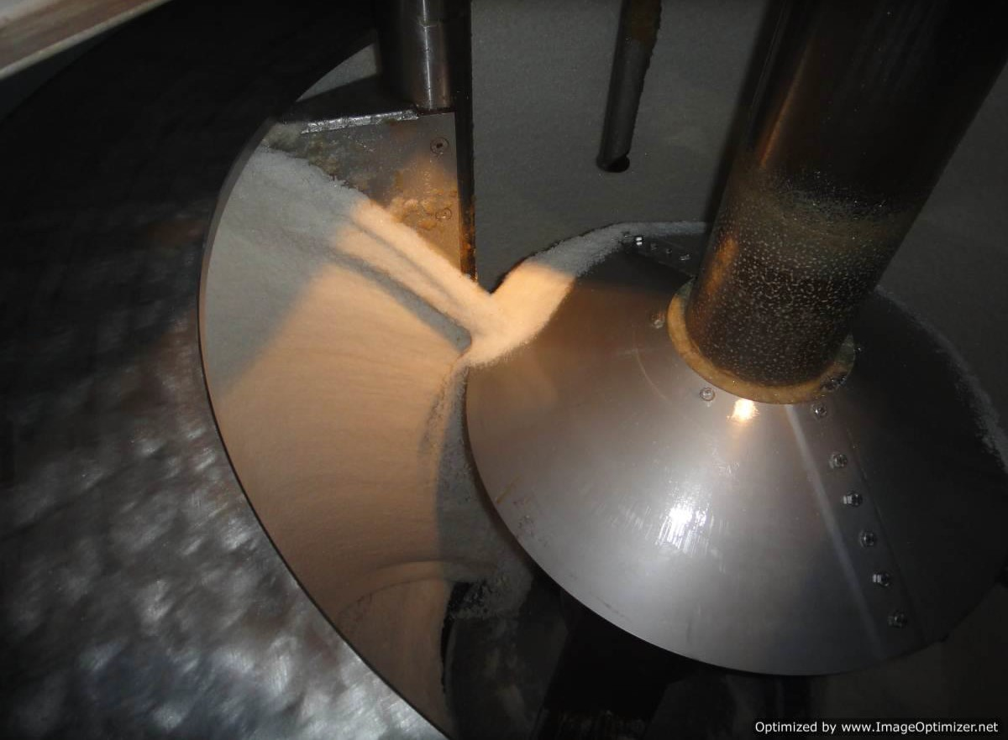
Need a good clean screen after ploughing out the sugar.
Any sugar remaining on the centrifugal screen is dissolved & recycled with basket wash
56

Slide 57
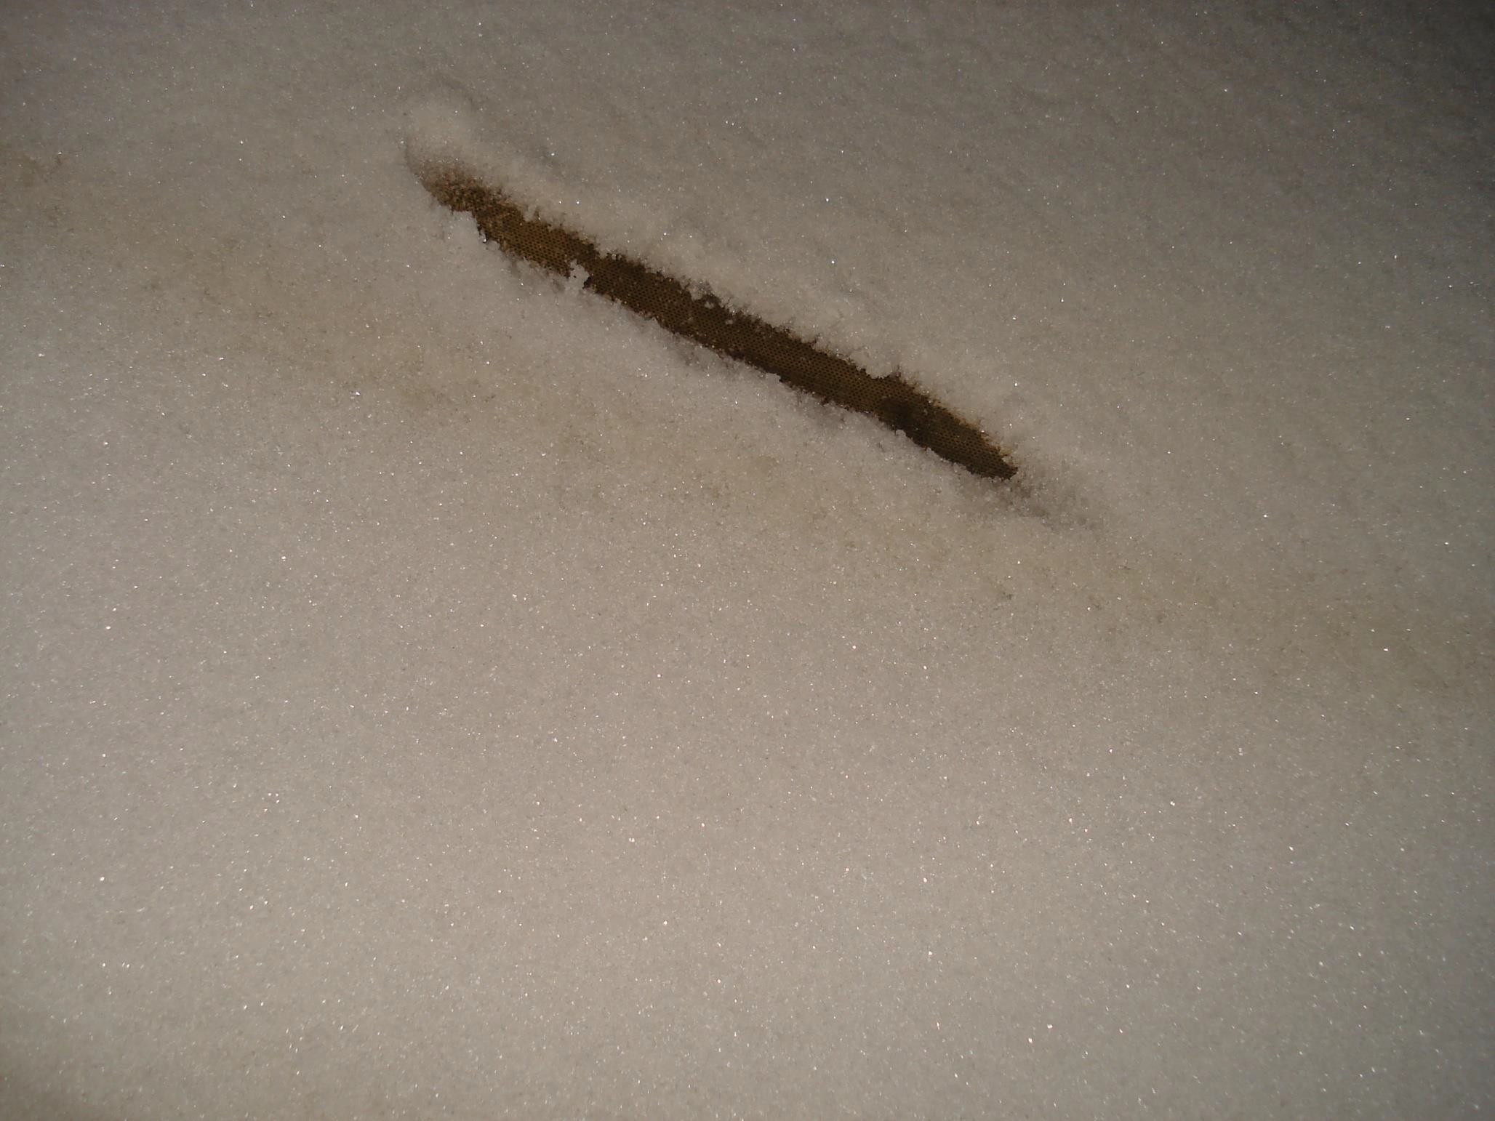
57
Not like this.
Close to 20 mm sugar left on this basket
(One machine like this will recycle nearly 40 ton
sugar a day)

Slide 58
58
Effect of poor ploughing & leaving sugar in basket
after ploughing.
Based on a K 1750 batch BMA. (Basket ∅ 1540 & ht 1170 Charge 1750kg)
Depth of sugar left on basket after ploughing (mm) | 1 | 2 | 4 | 10 | 20
Sugar left on Basket (kg) | 4.7 | 9.4 | 18.8 | 46.7 | 92.8
Kg Sugar Recycled / day (24 hrs and 18 cycles / hr | 2,029 | 4,056 | 8,101 | 20,176 | 40,099

Slide 59
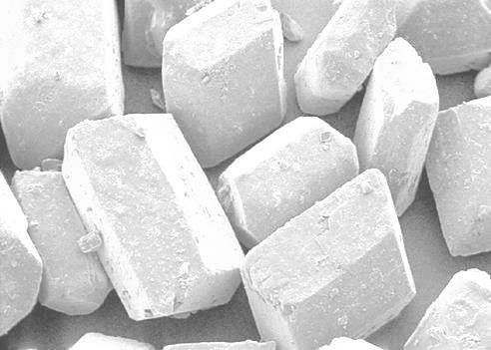
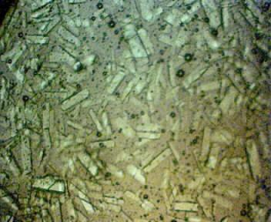
59
Need good square regular grain with voids
between for the runoff to purge through

Slide 60
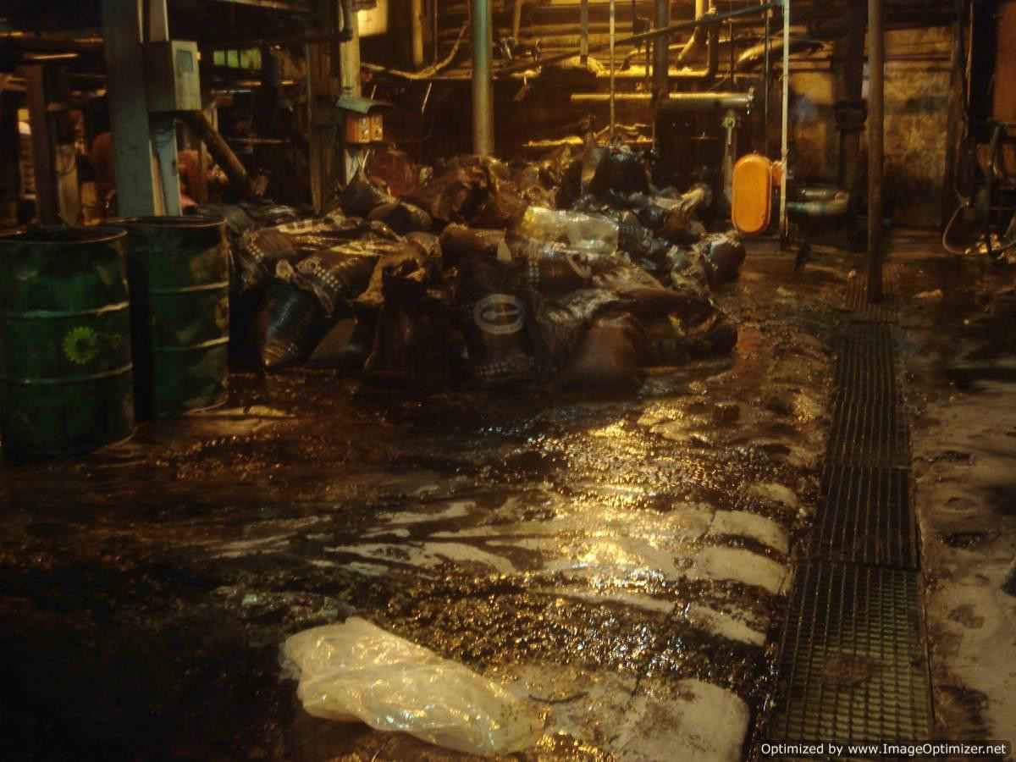
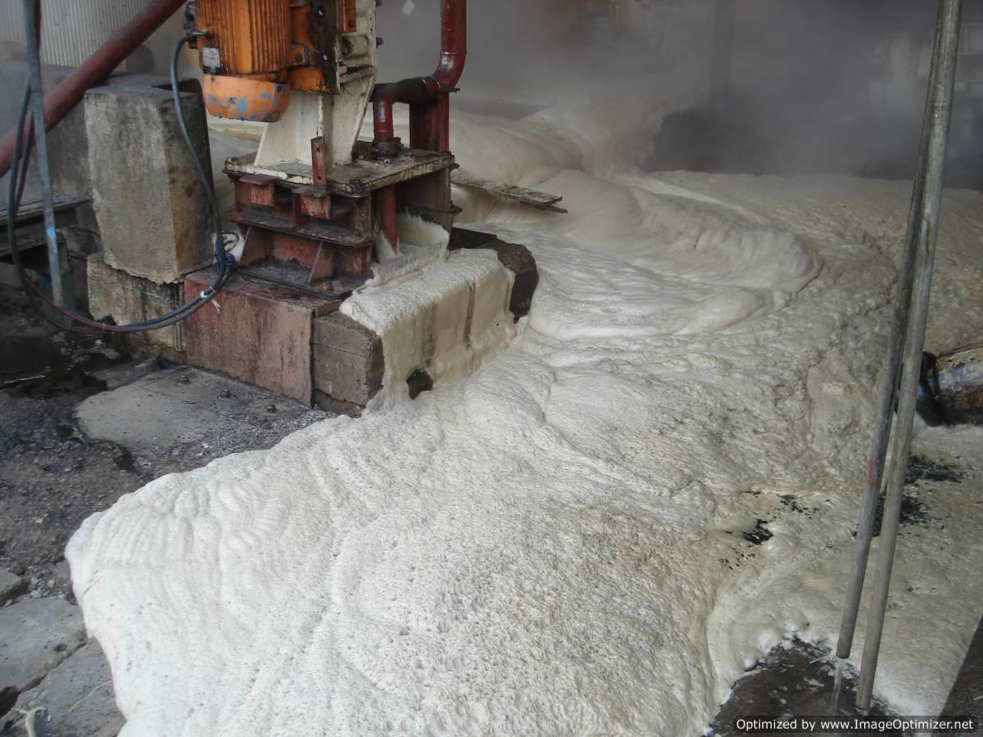
60
As mentioned before, even the best reclaim
implementation will not reclaim every bit from
spills.
Some sugar will be physically lost to drain
Some sucrose will get lost through degradation

Slide 61
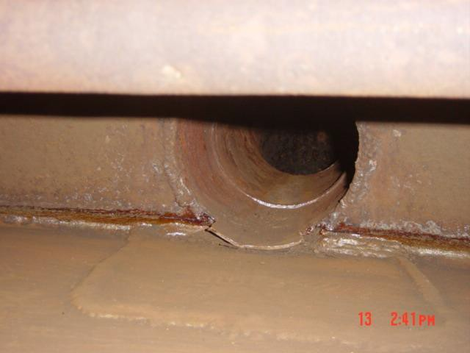
61




Not the best entrainment drain

Slide 62
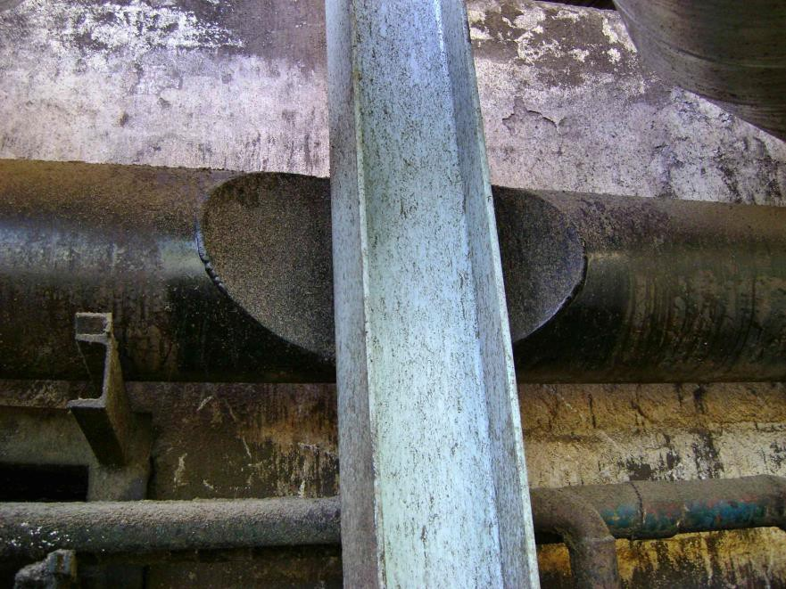
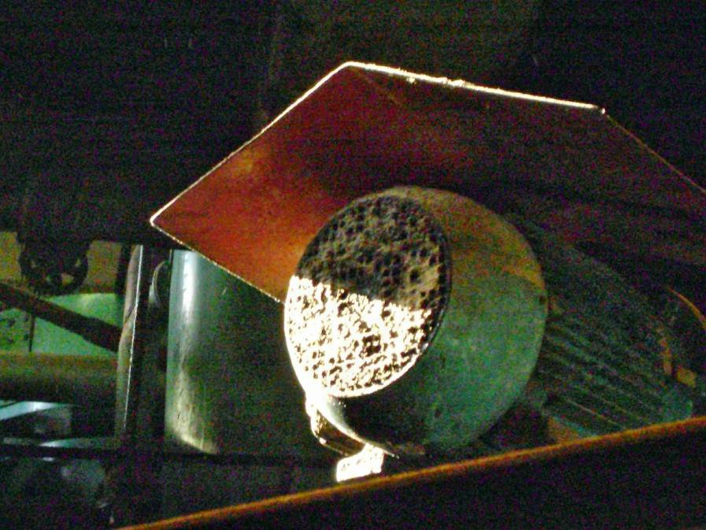
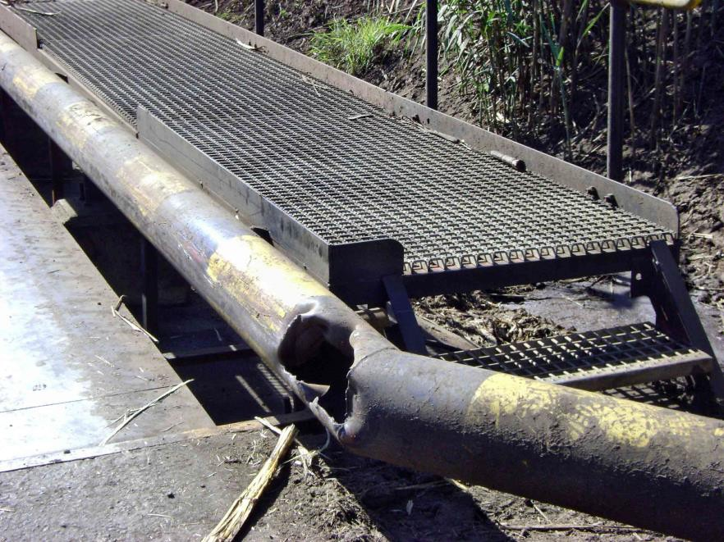
62
Some basic problems that can do with
attention

Slide 63
Conclusion
63
Good manufacturing practice is simply decisions taken in reducing sugar losses.
good
We have discussed a few examples of options that can be taken to reduce sugar losses.
The effort taken to systemise good manufacturing practice can have significant financial returns
Management support from the top is imperative to keep such initiatives from loosing focus.

Slide 64

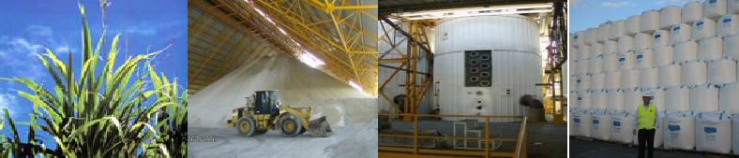



THANK YOU FOR YOUR ATTENTION!

